Slide 1
Intro to Python Week 5

Slide 2
Overview
random in Python
while loop
while loop and else statement
for loop

Slide 3
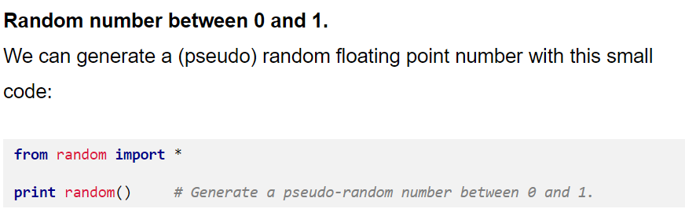
Import random
* Takes no arguments

Slide 4
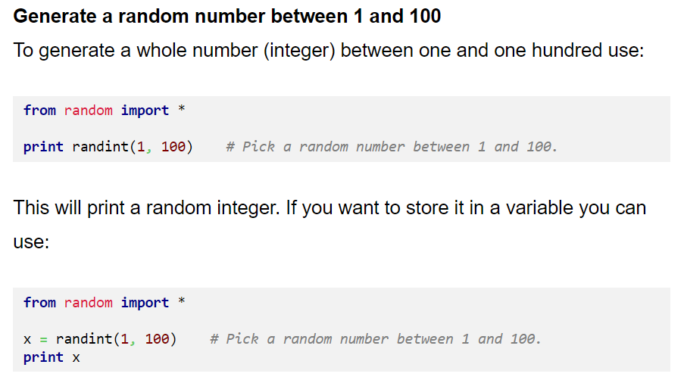
Import random

Slide 5
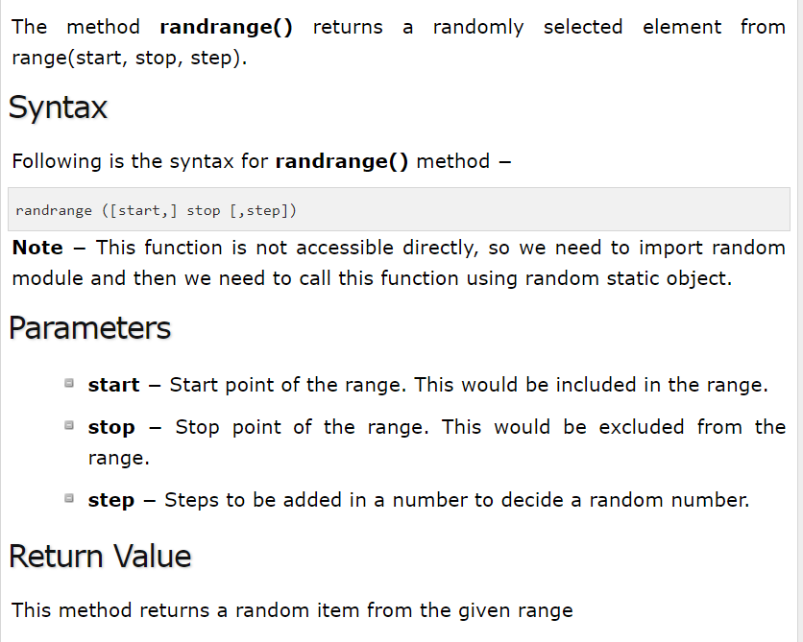
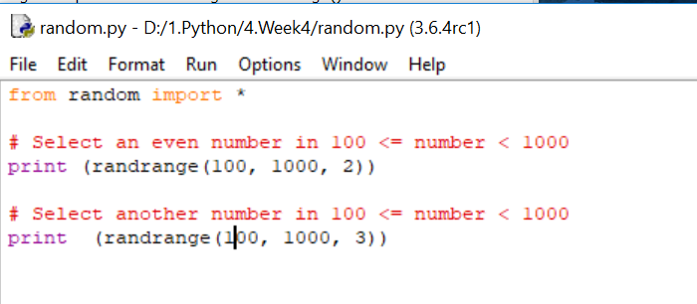
Import random

Slide 6
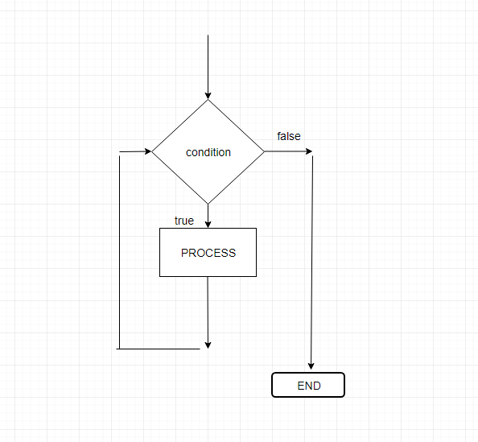
while loop
A while loop statement in Python programming language repeatedly executes a statement as long as a given condition is true.
Syntax:
while expression:
statement(s)

Slide 7
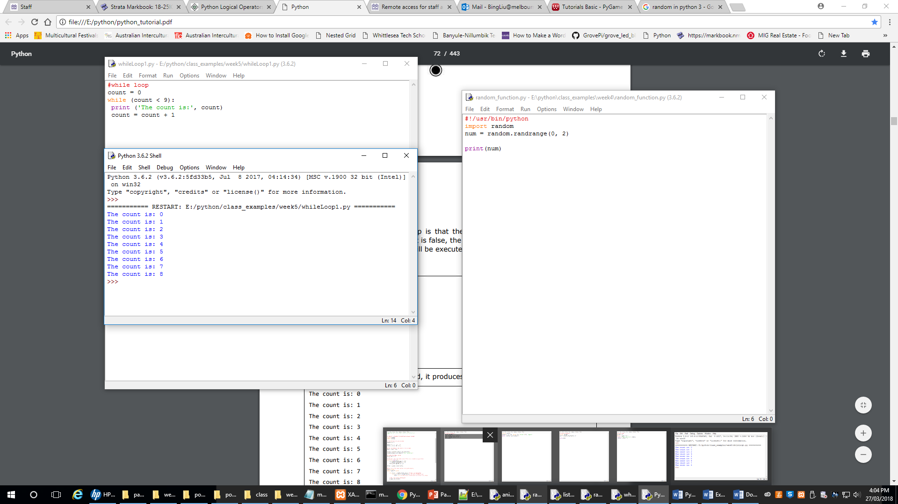
Example of while loop

Slide 8
Flowchart and Pseudocode
START
Assign count = 0
START Terminal
SET count=0
while count is less than 9
PRINT count
SET count = count + 1
END Terminal
while count <9
Display false statement
Display count
END

Slide 9
Infinite loop
A loop becomes infinite loop if a condition never becomes FALSE. You must use caution when using while loops because of the possibility that this condition never resolves to a FALSE value. This results in a loop that never ends. Such a loop is called an infinite loop.
Example:
count = 0
while (count < 9):
print ('The count is:', count)
Notice that count = 0 forever true, so it cause an infinite loop
In your GrovePI practice, there is
while True:
Which is an infinite loop

Slide 10
for loop
It has the ability to iterate over the items of any sequence, such as a list or a string.
Syntax:
for iterating_var in sequence: statements(s)

Slide 11
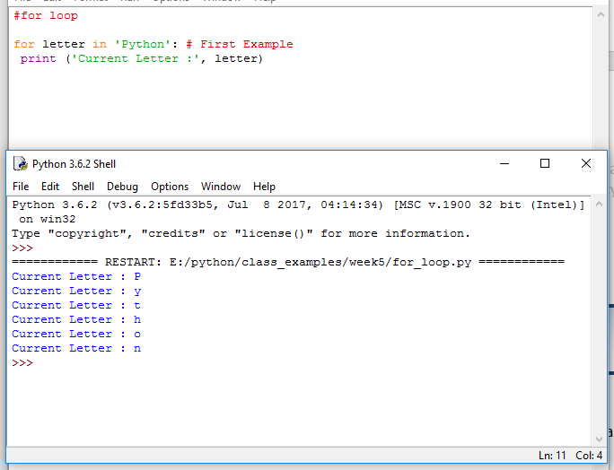
Example of for loop - 1
Notice that the program picks each character from a letter “Python”

Slide 12
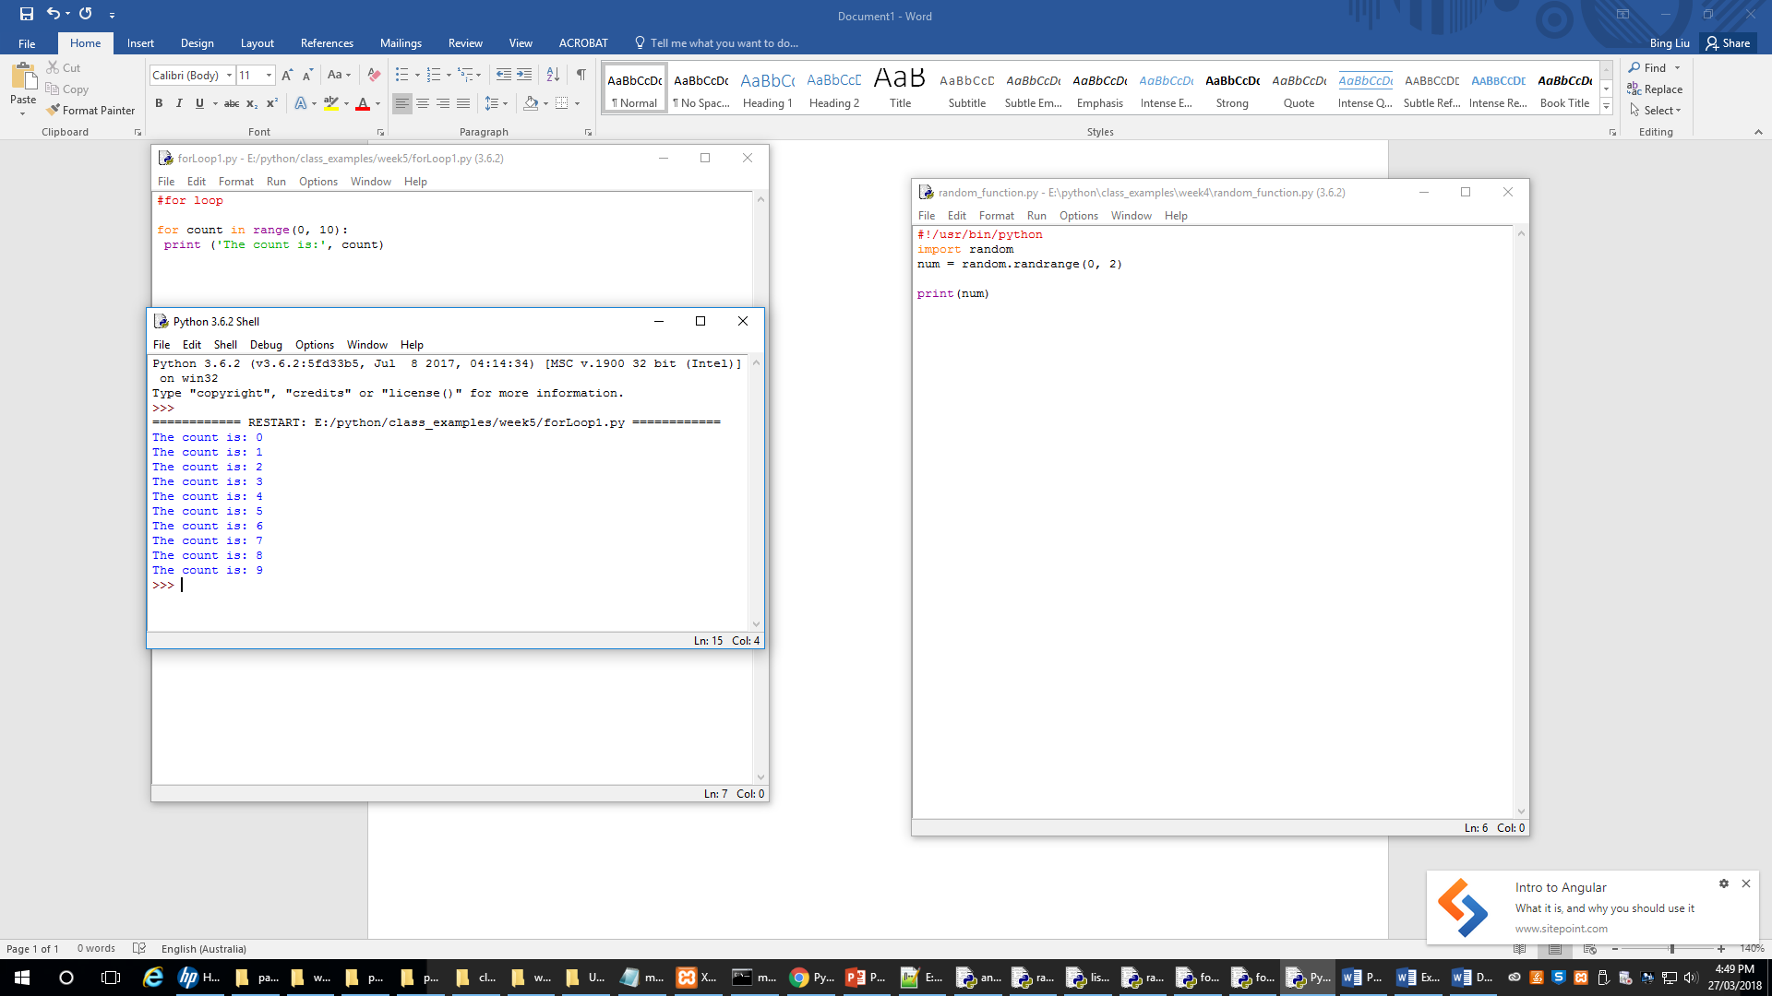
Example of for loop - 2
Notice that this program has the same result of while loop on slide 9

Slide 13
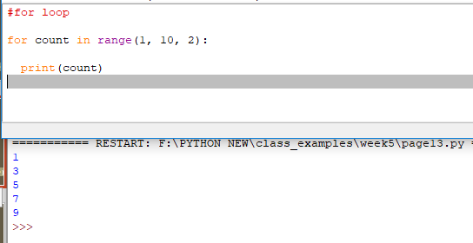
Example of for loop – 3 Step by 2
Notice that this program displays odd numbers

Slide 14
Break for loop
There is a time to stop the loops.
Example:
#using while loop
phone = input("Please enter a password: ")
for count in range(1, 3):
if(phone.isdigit() != True):
print("The password has to have letters and numbers")
phone = input("Please enter a password again: ")
else:
print("You got it!")
break
If number >0
Display message

Slide 15
Example of using grovepi (while loop)
import time
from grovepi import *
led = 4
i=0
while i<10:#light on and off only 10 times
digitalWrite(led, 1)
time.sleep(1)
digitalWrite(led, 0)
time.sleep(1)
i=i+1

Slide 16
Example of using grovepi (for loop)
import time
from grovepi import *
led = 4
for i in range(0, 10):
digitalWrite(led, 1)
time.sleep(1)
digitalWrite(led, 0)
time.sleep(1)

Slide 17
Catching the errors
Using try ….. except
IOError: if the file cannot be opened
ImportError: If Python cannot find the module
ValueError: an inappropriate value
TypeError: an inappropriate type
Please note there are more errors

Slide 18
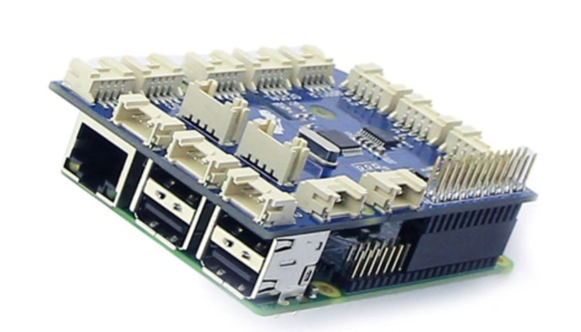
grovepi
The GrovePi is an Internet of Things Raspberry Pi robot kit that comes with 12 sensors and modules for creating your own smart devices.

Slide 19
Example of using grovepi (while loop)
import time
from grovepi import *
led1 = 4
led2 = 2
led3 = 3
i=0
while i<10:
digitalWrite(led2, 1)#blue light on
time.sleep(1)
digitalWrite(led2, 0)#blue light off
time.sleep(1)
digitalWrite(led3, 1)#green light on
time.sleep(1)
digitalWrite(led3, 0)#blue light off
time.sleep(1)
digitalWrite(led1, 1)#red light on
time.sleep(1)
digitalWrite(led1, 0)#red light off
time.sleep(1)

Slide 20
Example of using grovepi (for loop)
import time
from grovepi import *
led1 = 4
led2 = 2
led3 = 3
for i in range(0, 3):
digitalWrite(led2, 1)#blue light on
time.sleep(1)
digitalWrite(led2, 0)#blue light off
time.sleep(1)
digitalWrite(led3, 1)#green light on
time.sleep(1)
digitalWrite(led3, 0)#blue light off
time.sleep(1)
digitalWrite(led1, 1)#red light on
time.sleep(1)
digitalWrite(led1, 0)#red light off
time.sleep(1)

Slide 21
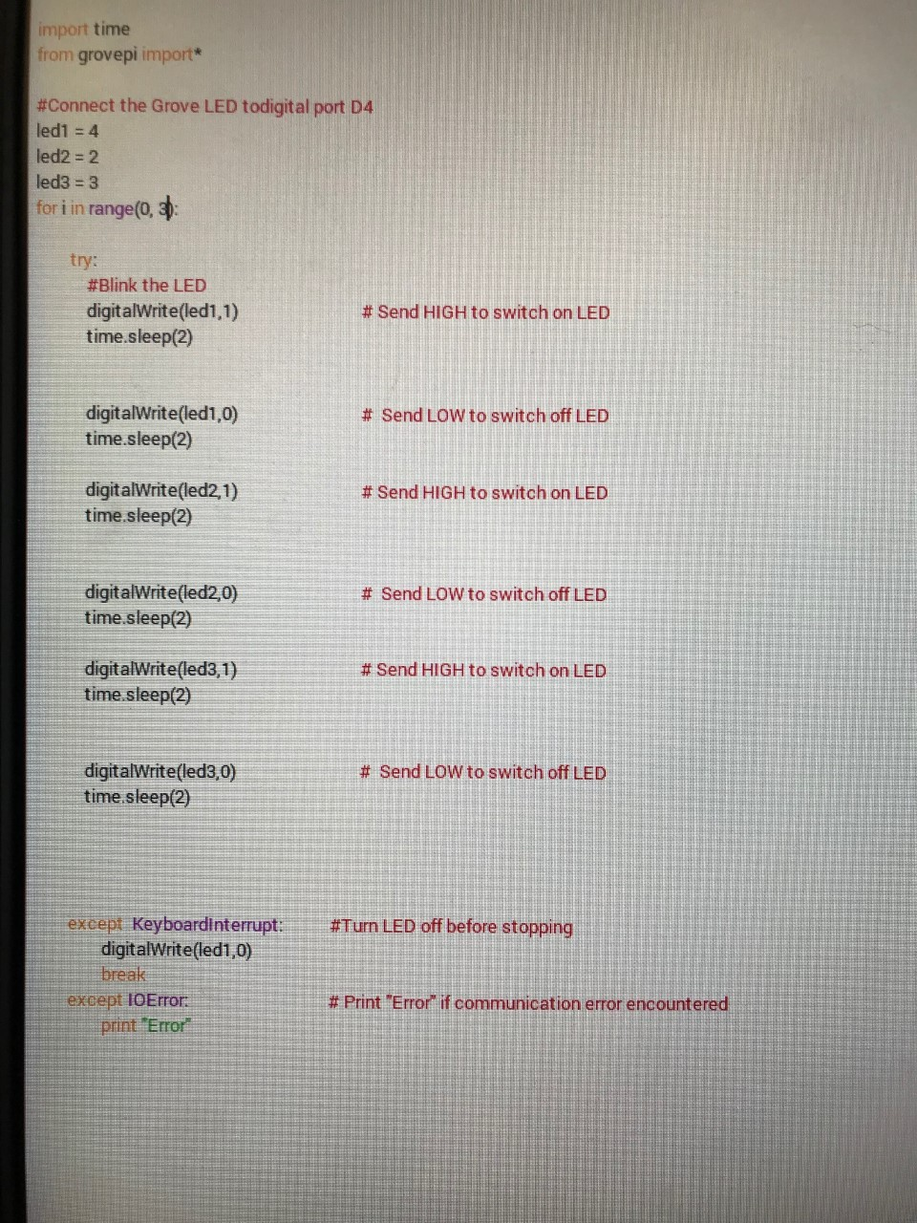
Example of using grovepi (error catch)

Slide 22
Reference
www.tutorialspoint.com
http://twitter.com/tutorialspoint
If number >0
Display message

